Slide 1

SQL – Stored Programs – Triggers & Views
Gerry Guinane
Limerick Institute of Technology
Topic 3 SQL Lecture 05

Slide 2
Learning outcomes
Learning outcomes – the student will be able to
Explain, Create and use TRIGGERS and VIEWS in MySQL

Slide 3
Stored Programs - Views
Views (including updatable views) are available in MySQL Server 5.6.
Views are stored queries that when invoked produce a result set. A view acts as a virtual table.
SQL Keywords:
CREATE VIEW
ALTER VIEW
DROP VIEW
Views can be created from any combination of other tables using SELECT and any valid expression

Slide 4
Views – advantages/disadvantages
A database view allows you to simplify complex queries: a database view is defined by an SQL statement that associates with many underlying tables. You can use database view to hide the complexity of underlying tables to the end-users and external applications. Through a database view, you only have to use simple SQL statements instead of complex ones with many joins.
A database view helps limit data access to specific users. You may not want a subset of sensitive data can be queryable by all users. You can use database views to expose only non-sensitive data to a specific group of users.
A database view provides extra security layer. Security is a vital part of any relational database management system. Database views provides extra security for a database management system. A database view allows you to create only read-only view to expose read-only data to specific users. Users can only retrieve data in read-only view but cannot update it.
A database view enables computed columns.
Performance: querying data from a database view can be slow especially if the view is created based on other views.
Tables dependency: you create view based on underlying tables of the a database. Whenever you change the structure of those tables that view associates with, you have to change the view as well.

Slide 5
View Example
With reference to the Parts Database – lets say we would like a table that would contain the latest shipping cost for materials.
Assume shipping cost is calculated based on weight – eg 35 euro per KG
In the PARTS table the weight of each item is available.
In the PARTS_REQUIRED table the number of parts from each supplier and for each project is listed.
We can get the cost of shipping any part based on its weight (in KG) multiplied by its shipping cost

Slide 6
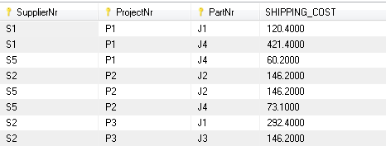
As a SELECT
SELECT p.S_NR as SupplierNr,
p.PART_NR as PartNr,
p.PROJ_NR as ProjectNr,
((p.REQUIRED_QTY*pa.WEIGHT)/1000)*43 AS SHIPPING_COST
FROM project_parts_required p, parts pa
WHERE p.PART_NR=pa.P_NR;

Slide 7
Next… as a VIEW
CREATE VIEW MATERIALS_SHIPPING_COST
AS
SELECT p.S_NR as SupplierNr,
p.PART_NR as PartNr,
p.PROJ_NR as ProjectNr, ((p.REQUIRED_QTY*pa.WEIGHT)/1000)*43 AS SHIPPING_COST
FROM project_parts_required p, parts pa
WHERE p.PART_NR=pa.P_NR;

Slide 8
Use the view
Lets say we want to know the shipping costs for each project – we can use the view:
SELECT
ProjectNr,
SUM(SHIPPING_COST) AS ProjectShippingCost
FROM
materials_shipping_cost
GROUP BY
ProjectNr;
ProjectNr | ProjectShippingCost
J1 | 412.8000
J2 | 808.4000
J3 | 537.5000
J4 | 2162.9000
J5 | 696.6000
J6 | 292.4000
J7 | 881.5000

Slide 9
Updateable/Insertable Views
Some views are updatable. That is, you can use them in statements such as UPDATE, DELETE, or INSERT to update the contents of the underlying table.
For a view to be updatable, there must be a one-to-one relationship between the rows in the view and the rows in the underlying table.
Certain constructs make a view non-updateable – eg Aggregate Functions (SUM, AVG..), GROUP BY , some Joins and so on.

Slide 10
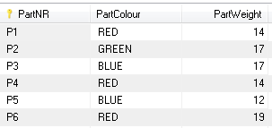
Updateable View
CREATE VIEW parts_detail
AS
SELECT
P_NR as PartNR,
COLOUR AS PartColour,
WEIGHT as PartWeight
FROM parts;
This view is updateable as it has a 1-1 relationship with the underlying table.
Any user who has write access to the View but not the underlying table will be able to change values of P_NR, COLOUR and WEIGHT but not part description in the underlying table

Slide 11
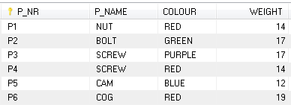
Update the view
UPDATE parts_detail
SET PartColour='PURPLE'
WHERE PartNR='P3';
Note – underlying table ‘parts’ has been updated:

Slide 12
SQL Triggers
A SQL trigger is a set of SQL statements stored in the database catalog.
In MySQL, a trigger is a set of SQL statements that is invoked automatically when a change is made to the data on the associated table.
A trigger can be defined to be invoked either before or after the data is changed by INSERT, UPDATE or DELETE statement.

Slide 13
Triggers are named objects in the DB
Triggers defined for a table must have a unique name.
You can have the same trigger name that defines for different tables but it is not recommended.
In practice, the names of triggers follow the following naming convention:
(BEFORE | AFTER)_tableName_(INSERT | UPDATE | DELETE)
ie:
[trigger time]_[table name]_[trigger event]

Slide 14
Create a Trigger in MySQL
In order to create a trigger you use the CREATE TRIGGER statement.

Slide 15
But First..Create a LOG table for suppliers
CREATE TABLE `suppliers_changelog`
( `eventID` int(11) NOT NULL AUTO_INCREMENT,
`eventType` varchar(45) DEFAULT NULL,
`eventTimestamp` datetime DEFAULT NULL,
`S_NR` varchar(45) DEFAULT NULL,
`S_NAME` varchar(45) DEFAULT NULL,
`STATUS` int(10) unsigned DEFAULT NULL,
`S_CITY` varchar(45) DEFAULT NULL,
PRIMARY KEY (`eventID`))
ENGINE=InnoDB
AUTO_INCREMENT=100
DEFAULT CHARSET=latin1;

Slide 16
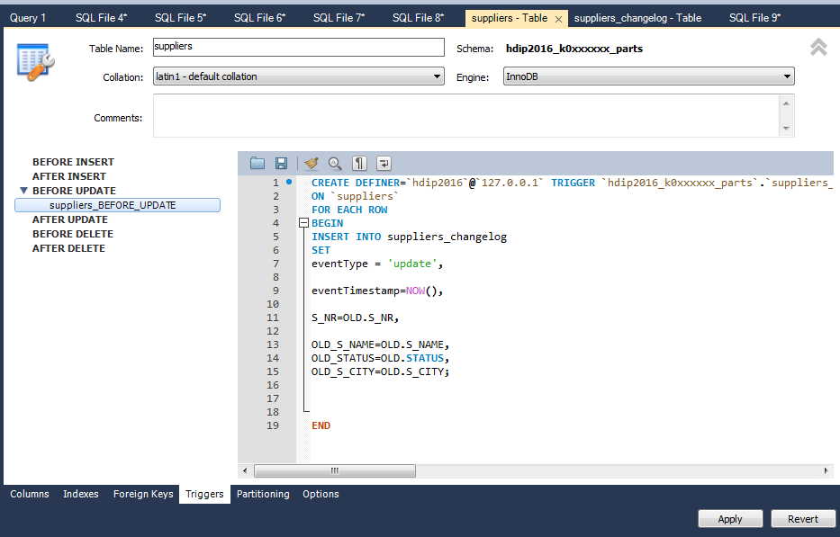
Create trigger (workbench)
Select the SCHEMA->Tables->tablename->ALTER TABLE
Where tablename is the ‘suppliers’ table
Select the Triggers tab, then select the type of trigger

Slide 17
Create BEFORE UPDATE trigger (code)
CREATE DEFINER = CURRENT_USER
TRIGGER `suppliers_BEFORE_UPDATE`
BEFORE UPDATE ON `suppliers`
FOR EACH ROW
BEGIN
INSERT INTO suppliers_changelog
SET
eventType = 'update_BEFORE',
eventTimestamp=NOW(),
S_NR=OLD.S_NR,
S_NAME=OLD.S_NAME,
STATUS=OLD.STATUS,
S_CITY=OLD.S_CITY;
END
If using the WORKBENCH wizard just insert the code in RED between the BEGIN..END

Slide 18
Create AFTER_UPDATE trigger
CREATE DEFINER= CURRENT_USER
TRIGGER `k0xxxxxx_parts`.`suppliers_AFTER_UPDATE`
AFTER UPDATE ON `suppliers`
FOR EACH ROW
BEGIN
INSERT INTO suppliers_changelog
SET
eventType = 'update_AFTER',
eventTimestamp=NOW(),
S_NR=OLD.S_NR,
S_NAME=NEW.
S_NAME,STATUS=NEW.STATUS,
S_CITY=NEW.S_CITY;
END

Slide 19
Try it out
Update any values in the supplier table (other than the supplier number)
Query the supplier_changelog table before and after executing the UPDATE query
Check that the two triggers have fired
UPDATE suppliers s
SET
s.S_NAME = 'Jones',
s.STATUS = 45,
s.S_CITY = 'Ennis'
WHERE s.S_NR = 'S3';

